Slide 1

Robust Spinning Sensing with Dual-RFID-Tags in Noisy Settings
Chunhui Duan, Lei Yang, Huanyu Jia, Qiongzheng Lin, Yunhao Liu and Lei Xie
April 18, 2018
Notes:
Good morning everyone. I’m Chunhui Duan from Tsinghua University, China. It’s my honor today to present our work named “Robust Spinning Sensing System with Dual-RFID-Tags in Noisy Settings”.

Slide 2
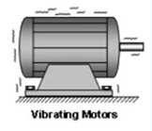
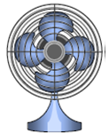
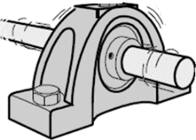
Mechanical Spinning
Motor
Fan
Centrifugation & testing
Smart factory
Mechanical spinning is a common phenomenon in everyday life
Notes:
People are subjected to spinning phenomenon in everyday life, like machines and motors. The spinning frequency is a crucial metric for many devices and we need to inspect it sometimes. For example, in smart factory, how fast the machine rotates determines whether it is in good operation.
Besides, centrifugation utilizes spinning to separate a mixture into different layers. And it is a necessary task to monitor such procedure.

Slide 3

Traditional Sensing Approach
Accelerator
Infrared
Notes:
Traditional approaches for spinning sensing requires specialized sensors. For example, we could attach an accelerator to a rotating machine for spinning diagnosis, or
using infrared ray to measure the rotating velocity. However, accelerators need physical contact to the machine with power supplied and suffer from frequency-selections and infrared ray fails in the absence of a line-of-sight to objects.

Slide 4
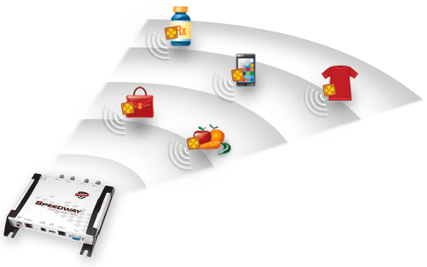
Sensing Spinning via RFID Signals
RF phase has high resolution and is sensitive to displacement
Cost-effective, applicable to occluded or NLOS objects
Tag’s ID can automatically associate the rotation with specific object
Notes:
In our work, we turn our attention to a mature technology RFID. Many industries have already attached RFID tags on their products. So we supplement the RFID backscatter communication with a fine-grained sensing capability. Compared to exiting spinning sensors, RFID-based sensing offers an appealing alternative. It is cost effective and applicable to occluded and non-line-of-sight objects. Moreover, the RFID tag contains the object ID, which can automatically associate the rotation with the particular object.

Slide 5
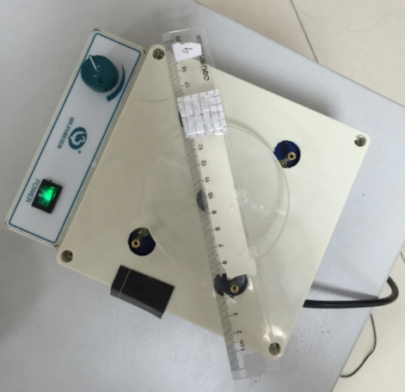
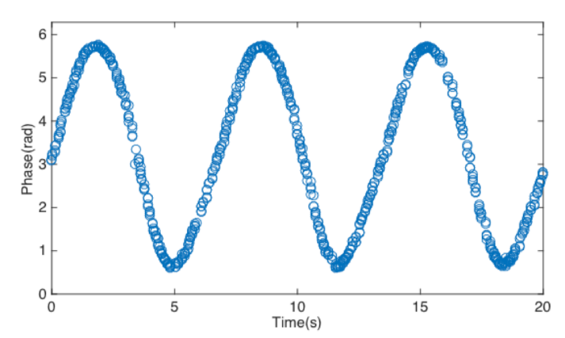
Spinning Signal in Quiet Setting
Tagbeat [Mobicom’16]
RFID tag
One reading/sampling
Turntable
Spinning signal
Spinning induced signal is discrete and periodic in quiet setting
Notes:
Sensing the spinning in quiet settings is straightforward, like previous work in Mobicom’16. A small and battery-free RFID tag is attached onto the spinning surface. Then it displaces the tag within a small range, resulting in a regular change pattern of the tag’s phase signal. We view each reading of the tag as one sampling of the rotation. As a result, the relevant spinning information like frequency or period can be inferred by discerning such communication pattern. Like the example shown here, spinning induced phase signal is discrete and periodic in quiet setting.

Slide 6
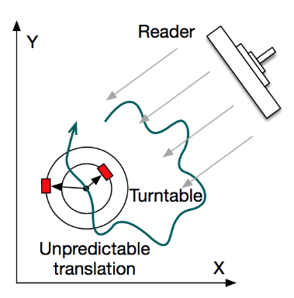

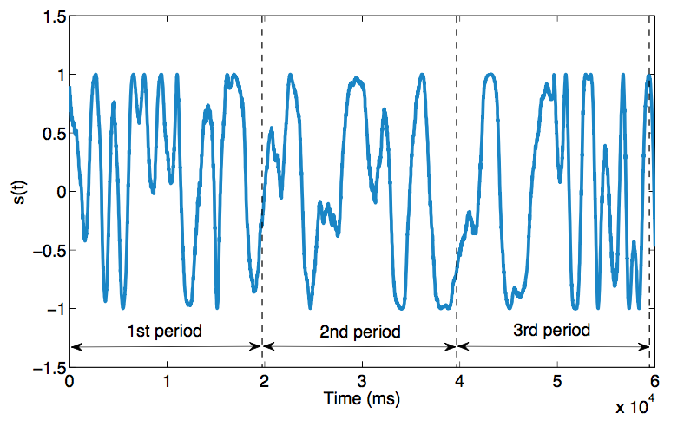
Challenge: Noisy Setting
Unpredictable translation
Hand shaking
Practical noisy settings break the periodic signal
Distorted spinning signal
Notes:
But previous work requires a very rigorous assumption that the devices must remain motionless or quiet, because any shaking of the reader or object, can disturb the periodicity of phase signal. However, in practical deployments, we can not perfectly assume such quiet setting. For instance, many industrial operations happen in unstable platforms (e.g. vehicles), whose shaking would lead to dramatic translation of device. Besides, the handheld reader’s shaking is also inevitable in actual measurement. So such noisy settings in practice would break the periodicity of the spinning signal. Like we can see here, the signal collected in a real noisy setting becomes totally distorted.

Slide 7
Contributions
Our Contributions
This work presents Tagtwins, a robust spinning sensing system that can work in noisy settings.
We develop two key techniques, to depict the shake-resilient sensing, and inspect high-frequency spinning respectively.
We implement the system purely with COTS RFID products.
Notes:
So to address the above limitation, in this work, we present a system named Tagtwins, which can robustly make sense of spinning and work in noisy settings.
In order to do this, we develop two key techniques, to depict the shake-resilient sensing, and inspect high-frequency spinning respectively.
Besides, we implement our system purely with commercial RFID products, demonstrating the feasibility of our design.

Slide 8
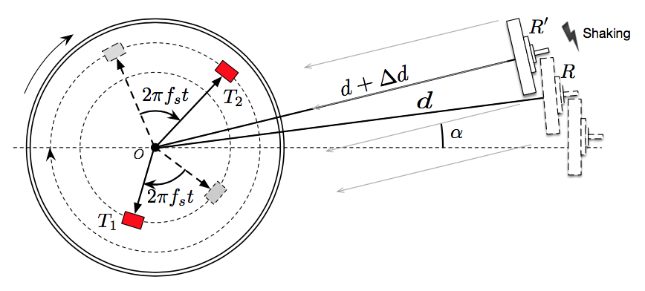
Anti-Shake Sensing
Attach dual RFID tags onto the spinning surface
No restriction on their geometric positions
Notes:
Now let’s go into the details.
Instead of utilizing only one RFID tag, we attach a pair of RFID tags onto the spinning surface and propose the anti-shake sensing method.
Of course we have no restriction on the two tags’ geometric positions as long as their relative position do not change during the measurement.
Why can dual tags resist device shaking? We assume the reader situates at a relative far distance, with direction alpha.

Slide 9
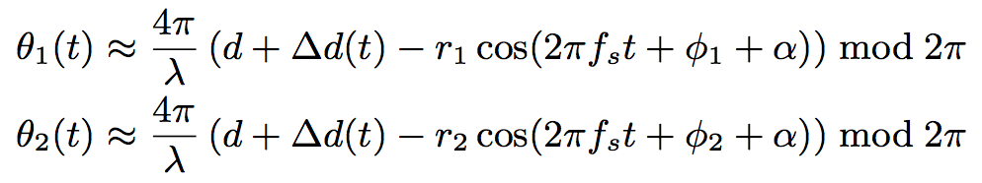
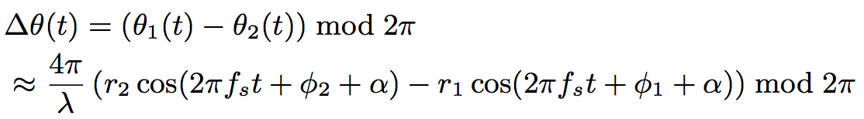
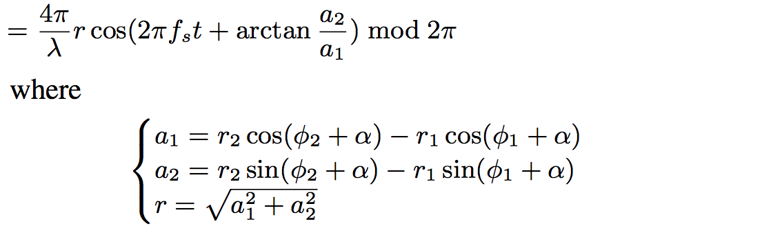
Anti-Shake Sensing
Respective phases of two tags
Unpredictable translation
Defined relative signal
Spinning frequency
$r$ is actually the separated distance of two tags
Notes:
Here theta 1 and theta 2 denote the two tags’ respective phases. Delta d is the unpredictable translation due to the shaking of reader or spinning object. Fs denotes the spinning frequency we wish to inspect. And we define the spinning signal as the relative phase delta theta between the two tags. We mathematically approve that delta theta is independent of device translation delta d and maintains the spinning frequency fs. Here $r$ is actually the separated distance of two tags. So although theta 1 and theta 2 may fluctuate with no regular pattern because of the unknown parameter delta d, the relative phase we define here is a periodic signal, no matter how devices shake.

Slide 10
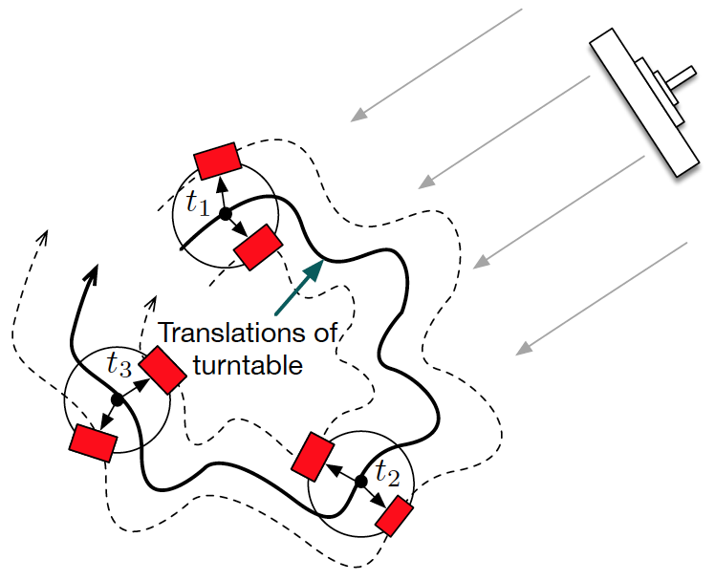
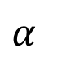
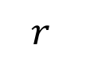
Anti-Shake Sensing
Tag 2
$$r$$
$$α$$
Tag 1
Relative phase only depends on the rotation itself instead of the shake induced translation
Notes:
We can also understand the relative phase from another intuitive perspective. Although the turntable or reader may translate randomly during spinning, the relative distance between two tags remains unchanged. So from the perspective of tag 1, tag 2 appears to move around tag 1 in a circle. Therefore, the relative signal only depends on the rotation itself instead of the shake induced translation.
We also demonstrate this can work even in multipath and 3D scenario, as long as reader’s angle of arrival alpha do not change.

Slide 11
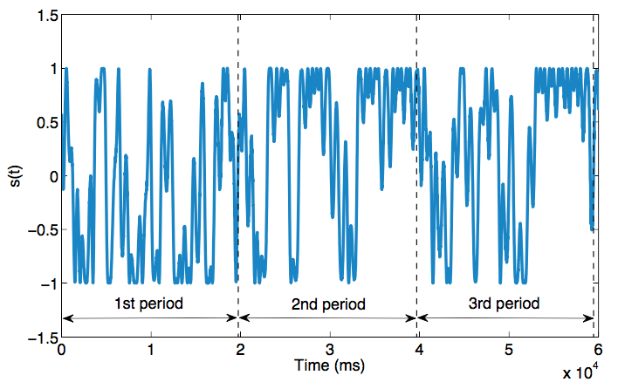
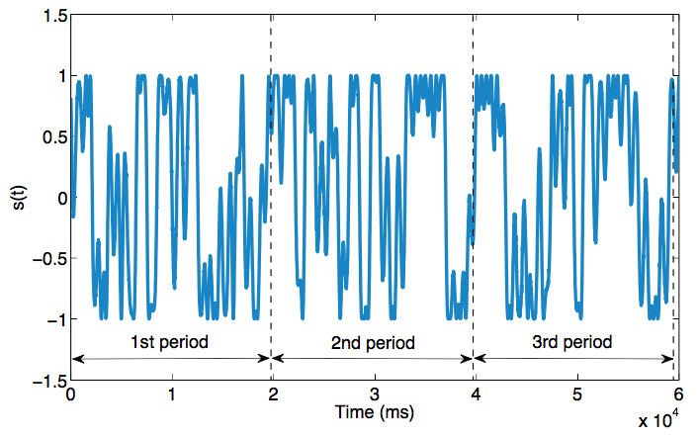
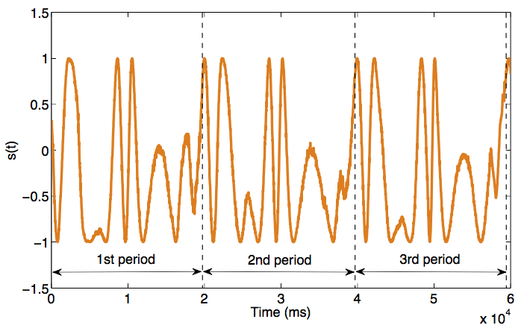
Relative Spinning Signal
Spinning signal of tag 1
Spinning signal of tag 2
Relative spinning signal
Notes:
Here show the phase signals of two tags respectively and their relative signal collected in a noisy setting. As we can see, both individual signals are seriously distorted, we cannot visually inspect the periods at all. But the relative spinning signal we define becomes far more regular and well reveals the original spinning frequency.

Slide 12

High Frequency Sensing
Time domain
Frequency domain
Nyquist sampling
RFID’s average reading rate ≈ 40Hz
<20Hz
Notes:
After we acquire the spinning signal, another problem is low sampling rate. As the Nyquist-sampling theorem states, in order to guarantee perfect reconstruction of a bandlimit signal, the sampling rate should be at least twice the highest frequency contained.
But nowadays, a commercial RFID reader can read tags 40 times per second on average, offering a sampling frequency of about 40Hz. According to the sampling theorem, we can only sense the spinning signal with a frequency of lower than 20Hz, which is apparently insufficient for many cases.

Slide 13
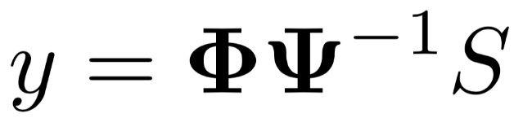
Compressive Sampling
Time domain
Frequency domain
Measurement result
Sparse representation
Measurement matrix
Time domain signal
Notes:
To inspect high frequency spinning with dual tags, we are inspired by compressive sampling technique. It shows that the sparsity of a signal can be exploited to perfectly reconstruct it from far fewer samples than required by the sampling theorem, if one can randomly measure linear combinations of the signal.

Slide 14
Compressive Sampling
Challenges:
Requiring a very sparse representation of the signal.
Scheduling the sampling based on a random measurement matrix, but the reading of COTS reader is out of control.
Notes:
To apply compressive sampling in our case encounters two challenges.
First, CS requires to project the signal in a special domain for a very sparse representation. Apparently, the time-domain signal is not so compact and sparse. Second, existing CS need to schedule the sampling based on a random measurement matrix created. The challenge is, we use commercial RFID reader. We are not able to access low-layer control information to schedule the reading.

Slide 15
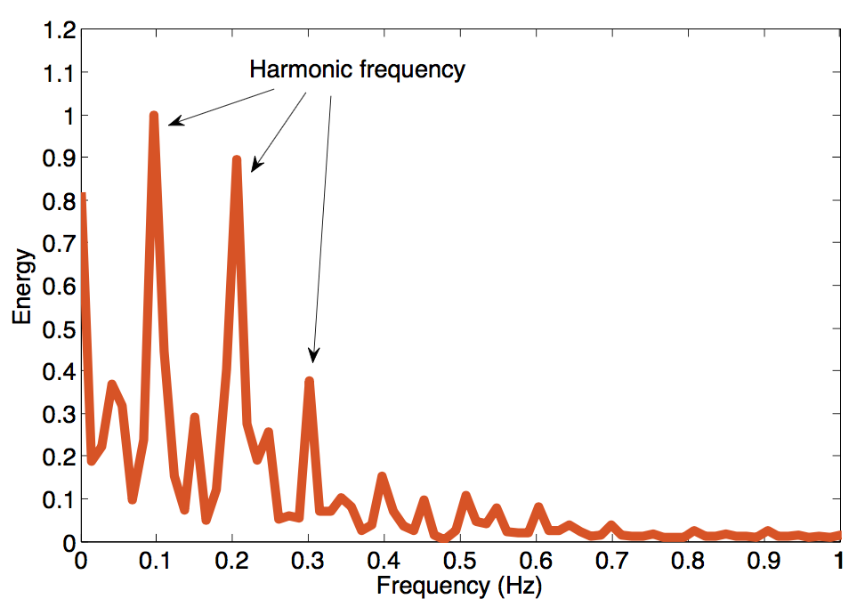
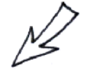
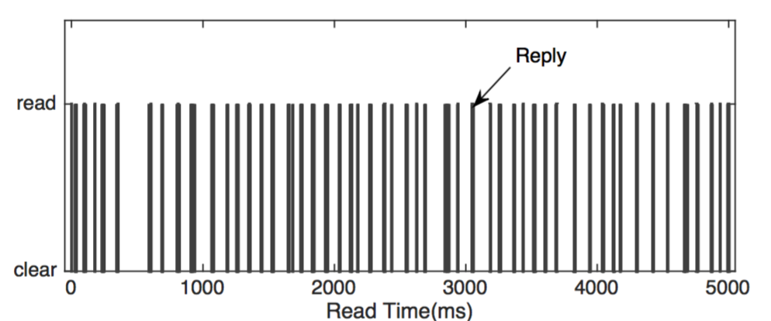
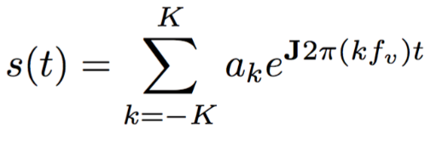
Compressive Reading
Random reading
Rotation signal has a very sparse representation in Fourier domain
COTS reader randomly reads tag, offering an inherent random sampling
Notes:
To accomplish this, our previous work propose compressive reading. As we have observed, the relative spinning signal is a periodic signal. It is well known that any periodic time signal can be expanded as a linear combination of its harmonic frequencies. Which means it is very compact and sparse in frequency domain.
For the second challenge, commercial RFID reader adopts the Q-adaptive algorithm to prevent tag collisions. Simply, it divides the time into small slots and allows tag to randomly pick up a slot to backscatter its ID. The random reading of commercial RFID device actually provides an inherent random sampling.

Slide 16
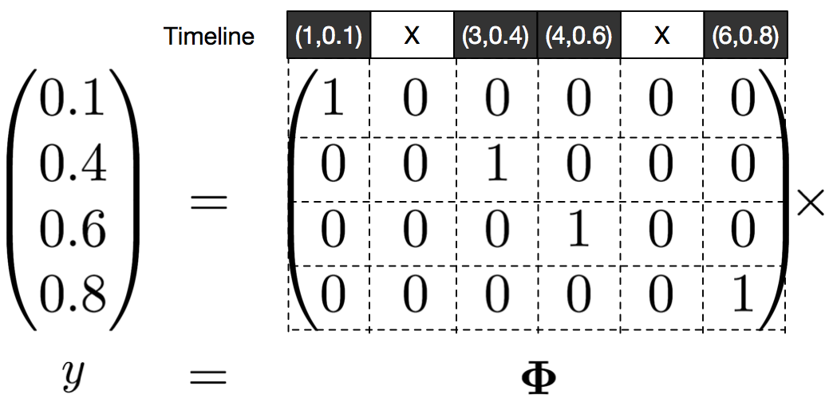
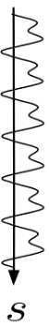
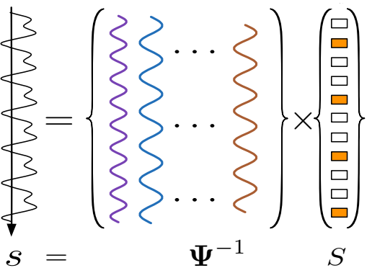
Compressive Reading
Construct measurement matrix
Measurement model
Signal model
Time domain signal
Sparse frequency domain
Notes:
By leveraging this, we construct the measurement matrix phi like this. Each row corresponds to one reading. And the ith column depicts whether the tag is read at the ith time slot. For example in this figure, if the tag is read at time 1, 3, 4, 6, then the 1, 3, 4, 6 column of the matrix is set to 1. The measurement result y is the collected phase. Unlike past systems, we construct the measurement matrix and sampling results based on the existing readings afterwards instead of making them beforehand.
Totally, we project the time-domain vibration signal into Fourier frequency domain and construct the measurement matrix after reading. Then we can recover the spinning signal by solving an l1-minimization problem through linear programming.

Slide 17
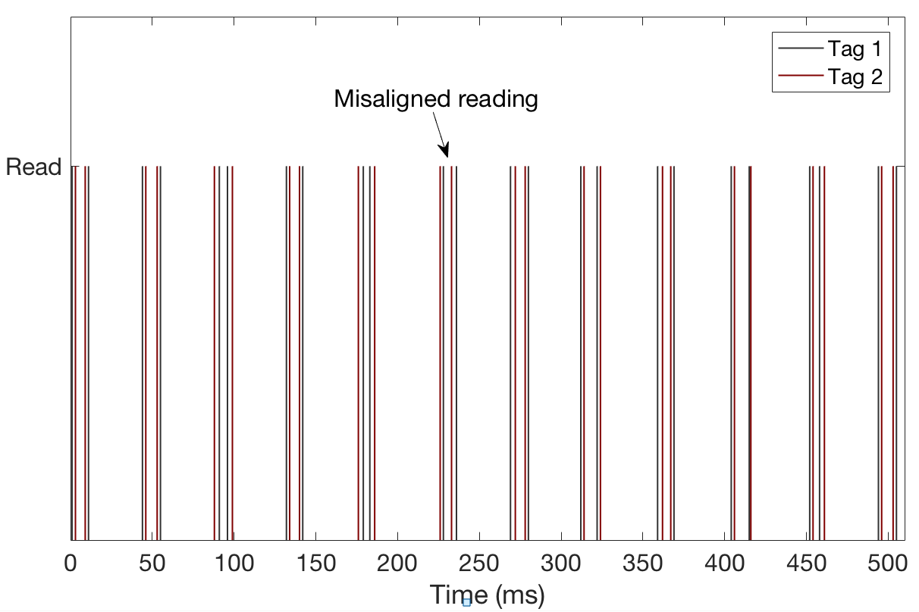
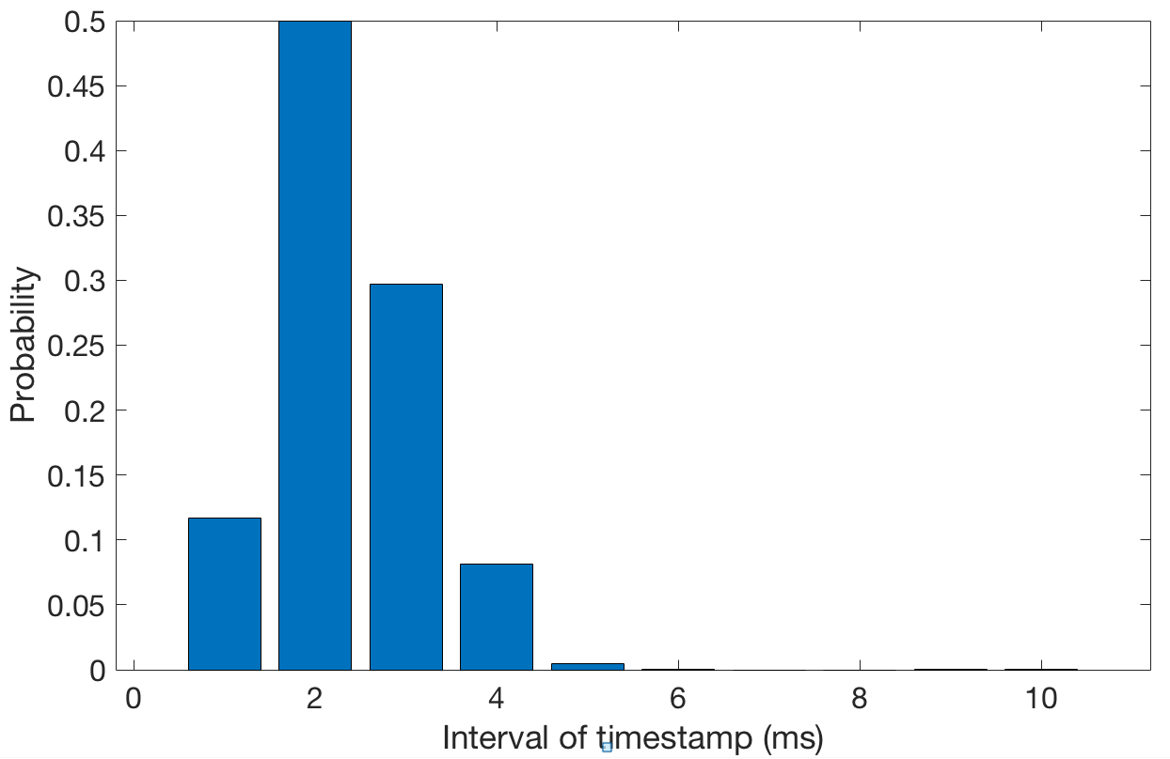
Enhanced Compressive Reading
Misaligned reading problem
Misaligned but close reading time of two tags
Interval distribution of two tags’ adjacent readings
Notes:
Everything looks like going well so far. But unfortunately, in our dual-tag scenario, we can not even acquire the relative phase of two tags in practice because tags are exclusively read in a time-sharing fashion to avoid collision. So it is impossible to read two tags’ phase values simultaneously at a specific time point, like this figure shows here. With more observations, we find that two tags are quite closely read although they are read alternatively. This is reasonable because the whole reading is composed of many inventory rounds, Each round lasts very short, making the reading time of two tags very close.
To validate, we show the interval distribution of two tags’ adjacent readings and find most of the interval are within 3ms. So we can assume two tags are almost read concurrently during each inventory.

Slide 18
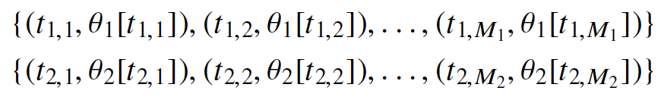
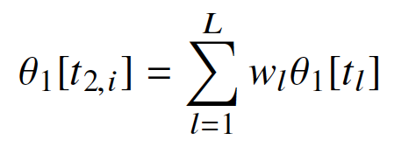
Enhanced Compressive Reading
Align phase sequences
Input phase sequences
Gaussian interpolation
Notes:
Driven by the above conclusion, we employ Gaussian Interpolation to align the two tags’ phase sequences.
Once they are aligned, we can recover the relative spinning signal as mention before. Then the fundamental frequency we want to inspect can also be obtained from the frequency spectrum of the recovered signal or using other fast folding approaches.

Slide 19
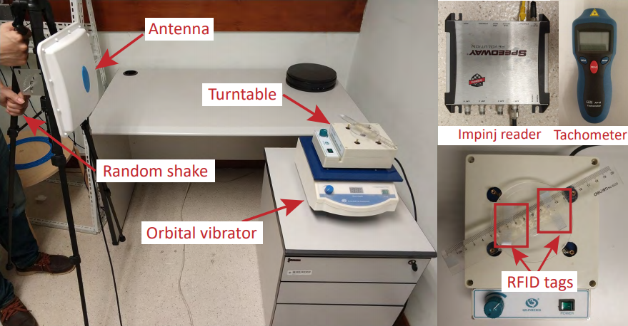
Experimentation
Notes:
We prototype our system and evaluate its performance.

Slide 20
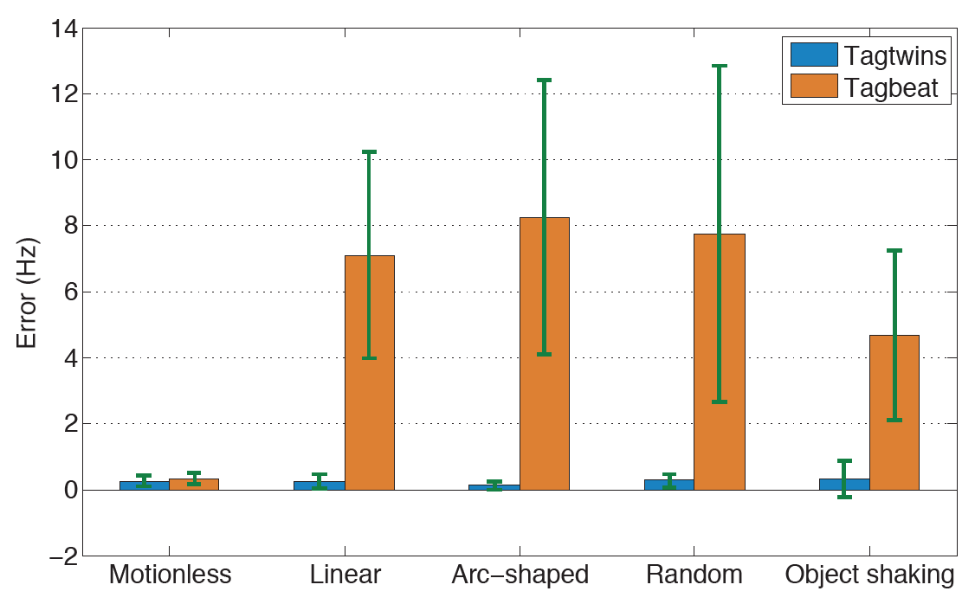
Evaluation
Overall anti-shake sensing accuracy
Mean error of 0.27Hz in frequency, corresponding to 0.43ms in period
Notes:
We first test our system robustness under various shaking scenarios from linear to random trajectory in noisy settings. And all of these shakes are performed up to a range of 30cm. We compare our approach with the previous work Tagbeat that only uses one tag for spinning sensing. As we can see, in noisy settings, our system can still maintains high accuracy while Tagbeat fails. Overall, the mean error is 0.27Hz in frequency, corresponding to 0.43ms error in period, which is very accurate and can even compare to those specialized sensors.

Slide 21
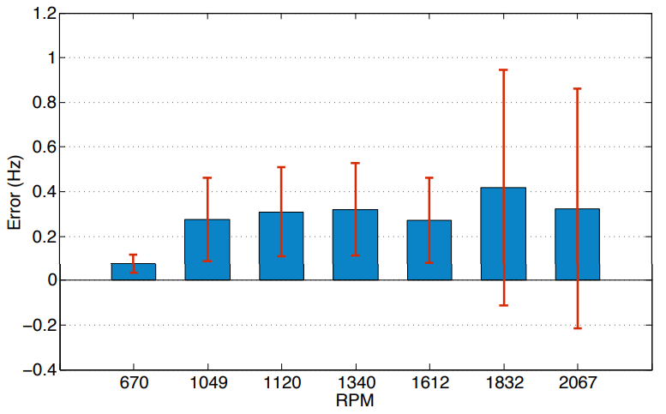
Evaluation
Accuracy vs. RPM
Our system achieves high accuracy in high frequency scenario
Notes:
We further check our system’s effectiveness under high frequency scenario, we tune the revolving speed of the turntable from to seven different levels. The result is still accurate even when the object spins at a high speed. And the result is more accurate when the object spins at a low speed, which is reasonable because more samples in one period can be collected for recovering.

Slide 22
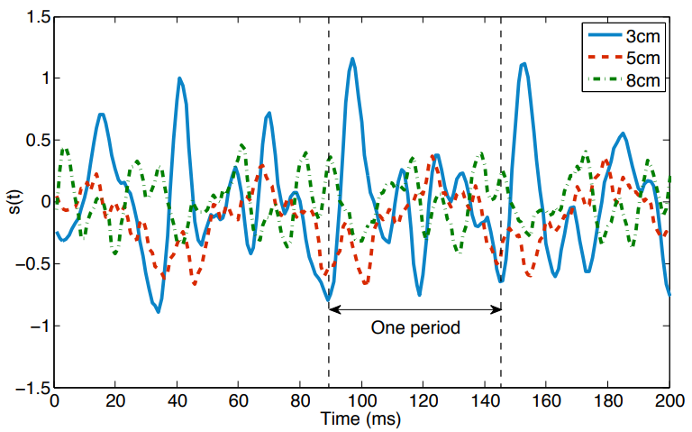
Evaluation
Impact of dual-tag distance
No special requirement of the dual tags’ geometric relationship
Notes:
As mentioned before, we have no requirement of the dual tags’ geometric relationship as long as their separation is fixed. Then we set this separation to 3cm, 5cm and 8cm respectively while keeping the same RPM and plot the recovered signals in this figure. We observe from this figure that although the shapes of three signals vary a lot, their periods keep consistent (i.e. about 57ms).

Slide 23
Contributions
Our Contributions
Addressing a practical problem of how to robustly and accurately sense mechanical spinning utilizing RFID.
Leveraging the relative signal of dual tags to maintain robustness in noisy settings.
Design the enhanced compressive reading technique to inspect high frequency spinning.
Notes:
To summarize, in this work, we address a practical problem of how to robustly and accurately make sense of mechanical spinning utilizing RFID. We leverage the relative signal of dual tags to maintain robustness in noisy settings and design signal processing technique to inspect high frequency signal.

Slide 24
Q&A
T
hank you
Notes:
That’s all of my talk today. Welcome for questions. Thank you.

